Slide 1

FLIGHT PRICE PREDICTION
Presented By:
NITISH KUMAR SHARMA

Slide 2
PROBLEM STATEMENT
Flight ticket prices can be something hard to guess, today we might see a price, check out the price of the same flight tomorrow, and it will be a different story.
The cheapest available ticket on a given flight gets more and less expensive over time. This usually happens as an attempt to maximize revenue based on -
1. Time of purchase patterns (making sure last-minute purchases are expensive)
2. Keeping the flight as full as they want it (raising prices on a flight which is filling up in order to reduce sales and hold back inventory for those expensive last-minute expensive purchases)
To solve this problem, we have scraped prices of flight tickets for various airlines between the months of October and December of year 2021 and between various cities from yatra website, using which we aim to build a model which predicts the prices of the flights using various input features.

Slide 3
EDA STEPS
We will start by importing the libraries that we require for performing EDA. These include NumPy for mathematic computation, Pandas for handling dataset, Matplotlib, and Seaborn for visualization. Then different regression models from sklearn for model building.
We will now read the data from CSV files into a Pandas DataFrame.
We will display top 5 rows by using .head() function to know if it has the right type to data in it or not.
Using .shape function to display total number of rows and columns present in the dataset.
Using .columns function to display all the features name present in the dataset.
We will now check datatype of each variables in data by using .info() function.
We will now display number of unique values in each features by using .nunique() function.

Slide 4
Then listing out categorical and continuous features from dataset.
Use describe() function to get statistical details like count, percentiles, mean, std, and maximum value of data.
We will now check for null values in the dataset. We will use isnull().sum() function. Dataset has no null values.
Changed the format of Date_of_Journey for better analysis view point and then splitted into number of months and days for visualization purposes.
Extracted hours and minutes from both features of Arrival Time & Departure Time for visualization with the target variable. Done feature engineering on duration column to split hours and minutes as done for above features.
Categorized Arrival hour and Journey month features for analysis purposes.
Now we will do univariate, bivariate analysis on the data to extract meaningful informations from it.

Slide 5
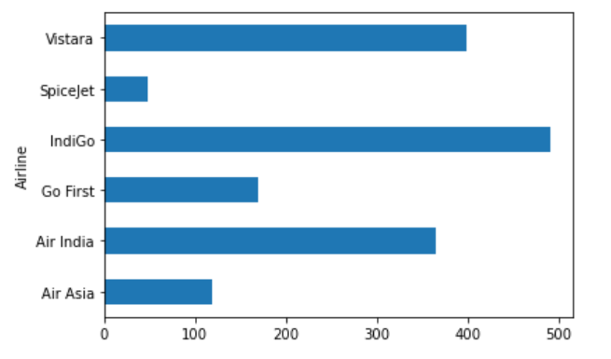
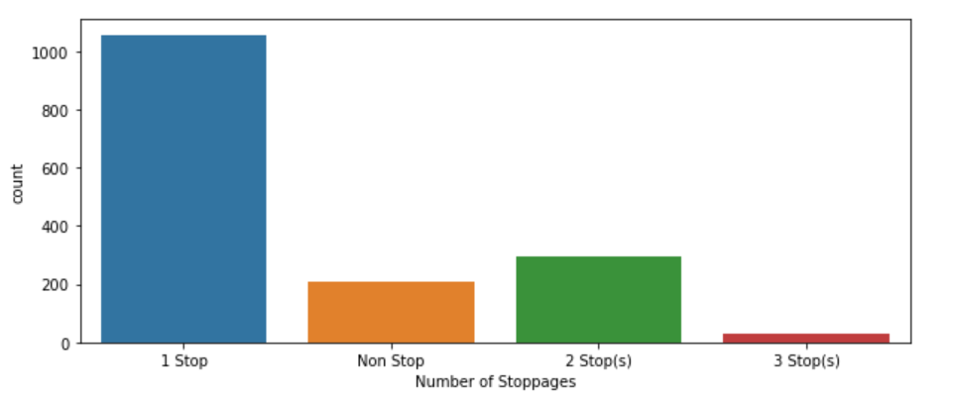
VISUALIZATIONS
Indigo flights will be available more from Oct-Dec month and Spicejet flights would be less available for passengers.
Maximum number of stoppages is only one for various routes(i.e source-destination).

Slide 6
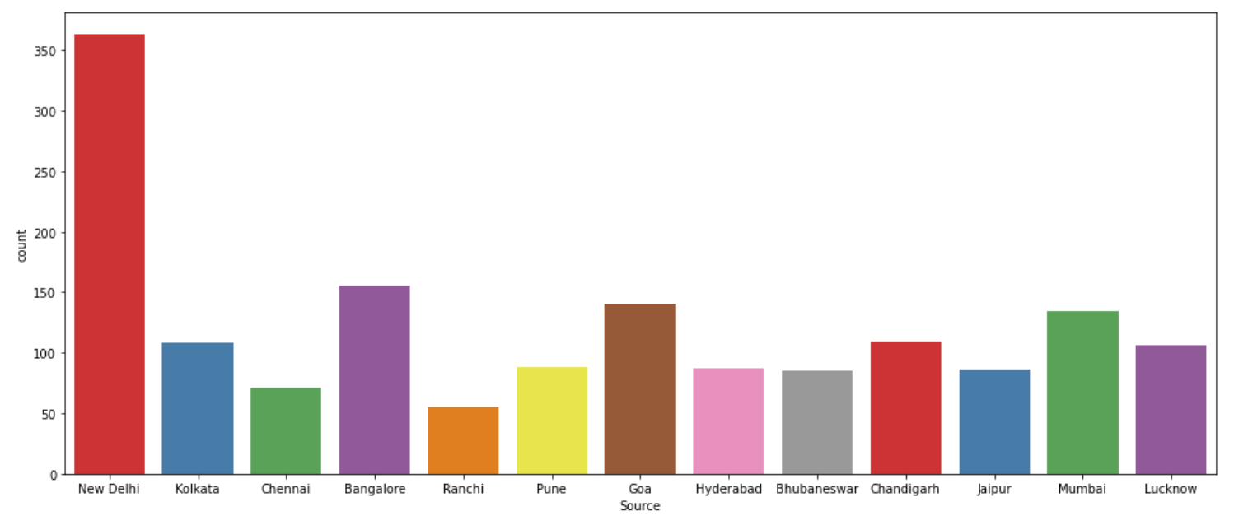
Mostly flights will take off from New Delhi and least from Ranchi in Oct-Dec month according to the data scraped for various routes.

Slide 7
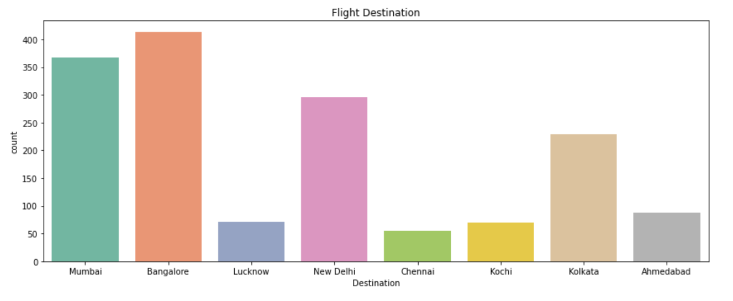
Maximum flights will land at Bangalore and least flights will land at Chennai.

Slide 8
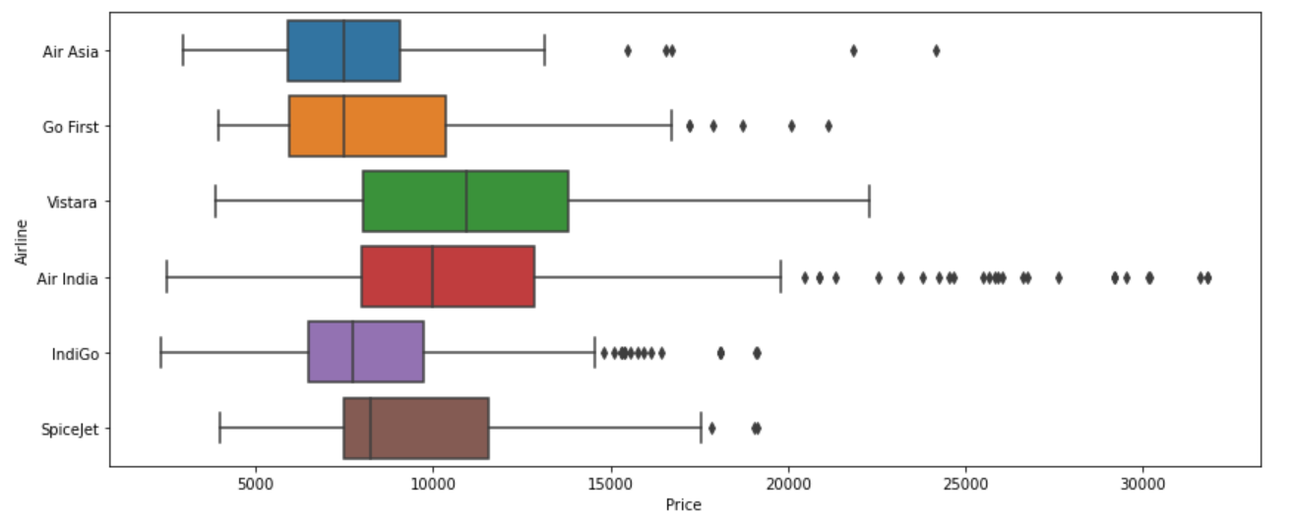
Air India flight price is costlier than other airlines for month of Oct-Dec 2021.

Slide 9
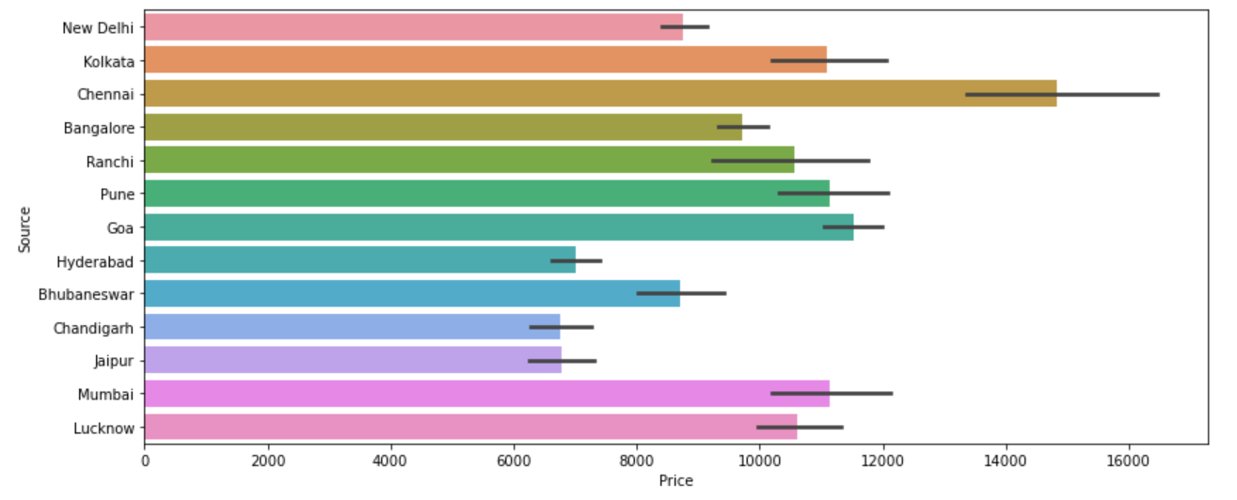
The price of flight ticket from Chennai is much high than other cities.

Slide 10
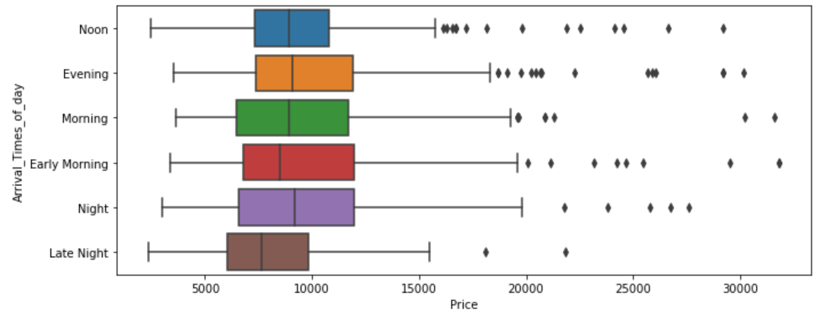
Price of flight ticket in evening & early morning is costlier and cheap in night when boarding to destination.

Slide 11
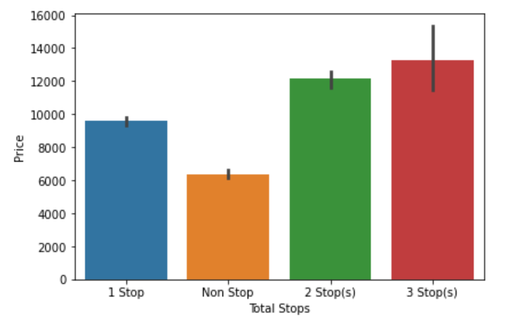
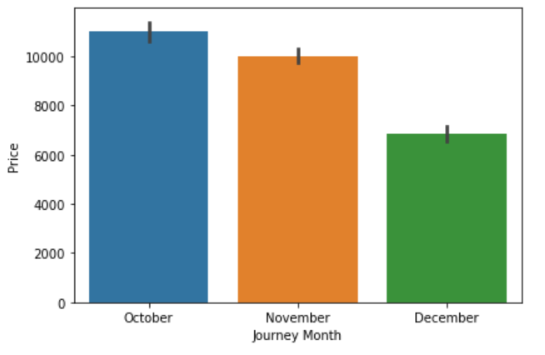
Price of flight ticket increases with increase in number of stoppages.
Price of flight ticket decreases with increase in month (i.e You will get ticket at low cost price if you book your ticket earlier)

Slide 12
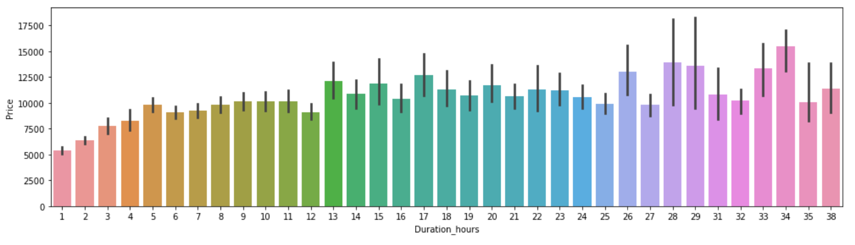
Maximum the duration of time taken by the flight to reach its destination , higher will be the ticket price.

Slide 13
STEPS & ASSUMPTIONS TAKEN
After data cleaning, Used label encoder to convert categorical variables of the data into machine language.
Visualized the features using distplot & boxplot and only duration hour feature was having outliers.
So treated the duration hour feature using 1.5 IQR method to remove outliers.
Checked for skewness in data and applied log transformation to remove skewness (i.e acceptable range +0.5 to -0.5)
Plotted heat map to see the correlation of independent variables with the target (Price) variable.
Used variance inflation factor to check for multi-collinearity.
Then started model building and testing with different algorithms to find best model and finally doing hyper parameter tuning to achieve good accuracy.

Slide 14
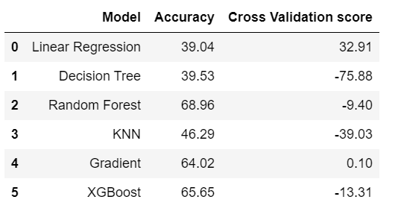
FINALIZED MODEL
Gradient Boosting Regressor is our best/finalized model because the difference between its accuracy and CV score is least among all models.
After applying hyper parameter tuning on our best model (Gradient Boosting Regressor) , the accuracy increased by 4.73%.

Slide 15
CONCLUSION
The analysis of heatmap showed that duration hour and journey month are important determinants of target (Price) variable for flight price prediction.
Only price variable was of continuous (int64) type rest all were categorical (object) type.
New Delhi is a hub from where maximum passengers board to various destination.
Indigo flight price is cheaper and Air India flight price is costlier than other airlines.
Flight price of various airlines is cheaper if booked ealier (i.e 1 or 2 months before).
Price of flight ticket increases with increase in number of stoppages.
Morning and evening flights are expensive compared to night flights.
Airfares changes frequently and always price tends to go up overtime .
Flight price increases drastically when heading towards the departure date.

Slide 16
THANK YOU!

